Slide 1


CompSci club
Review of Python
Hello there! Thanks so much for coming back! We have so much planned!

Slide 2
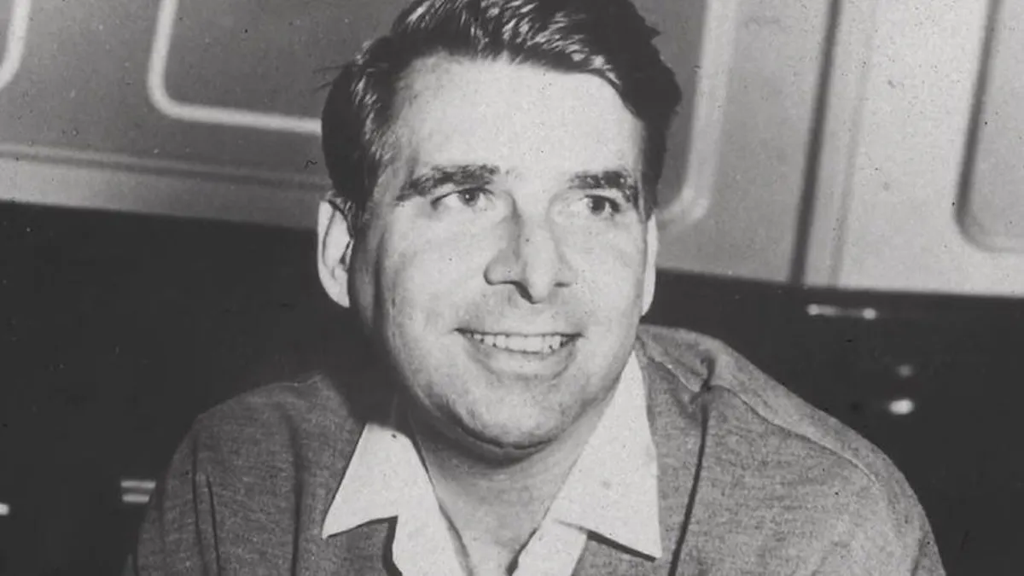
Our person of the day!
Eugene Wesley Roddenberry
September is home to a multitude of historic events, but but one of the biggest impacts on pop culture is the creation of Star Trek, which had its first episode premiere on September 8, 1966
Eugene Wesley Roddenberry (better known as Gene Roddenberry) is the creator of Star Trek
Roddenberry's served in the military, which inspired him to make television shows. Star Trek was Roddenberry’s dream, where a large chunk of the galaxy worked together harmoniously
Roddenberry had a vision for a Earth to be a peaceful place and for people not to work for money, but to help others
Star Trek had a massive legacy on pop culture communications and computing
Creator of Star Trek

Slide 3



Roadmap for Today
Set Up Repl.it & GitHub
Let us set up our coding environment and Version Control!
Review of the Basics
Let's review what we did last year and see where everyone is at!
Practice
Let's practice what we reviewed!
Notes:
Ask what Github is and what version control is

Slide 4
The easy (& fun) part (we hope!)
Set Up
Repl.it & GitHub

Slide 5
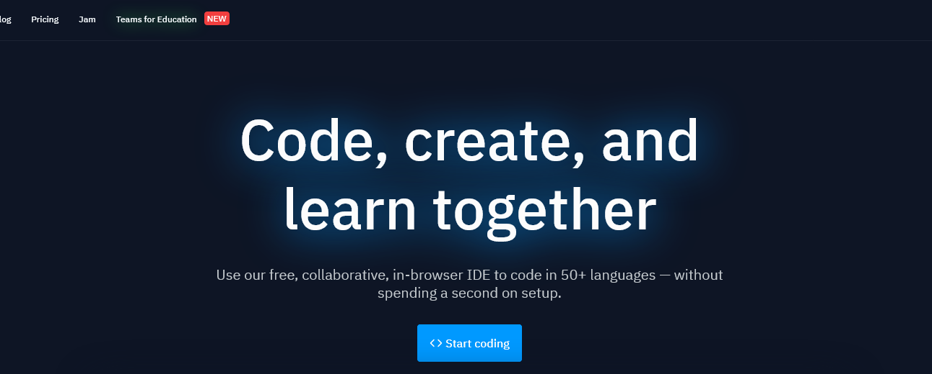
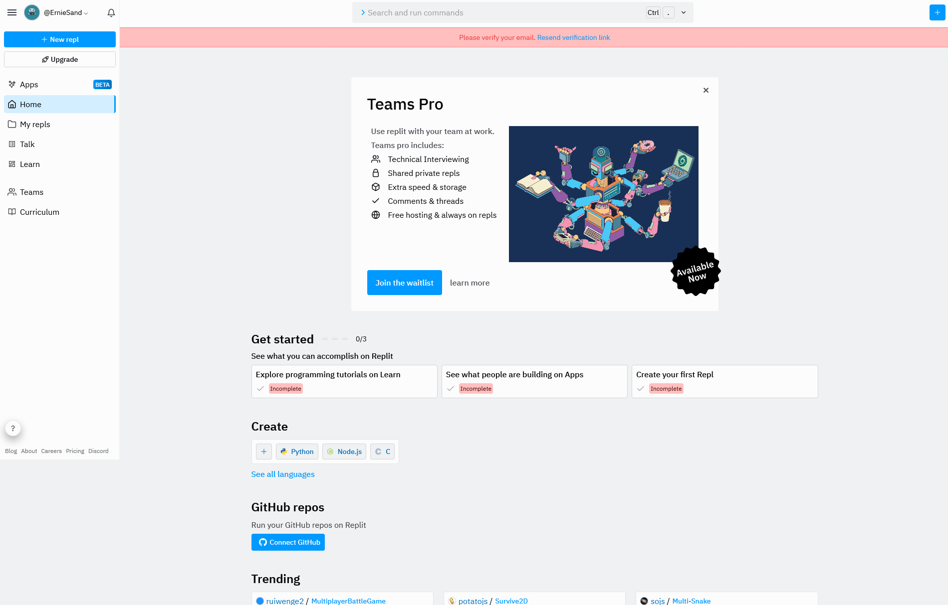
What will we be using to code?
To code, we will be using a Cloud Integrated Development Environment (IDE) called Repl.it
An IDE is an application that allows us to be able to write and execute our code all in one place instead of having to use a text editor and the terminal
Being in the cloud, we can access Repl.it from anywhere, including our Chromebooks!
Many of these cloud IDEs work like Google Apps and allow us to have multiple users edit a single file at the same time
To get started, go to https://www.Replit.com
Sign up using your Raleigh Charter Email Address

Slide 6
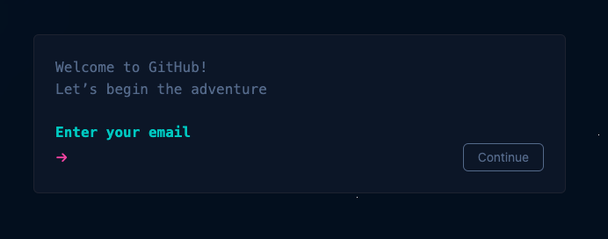
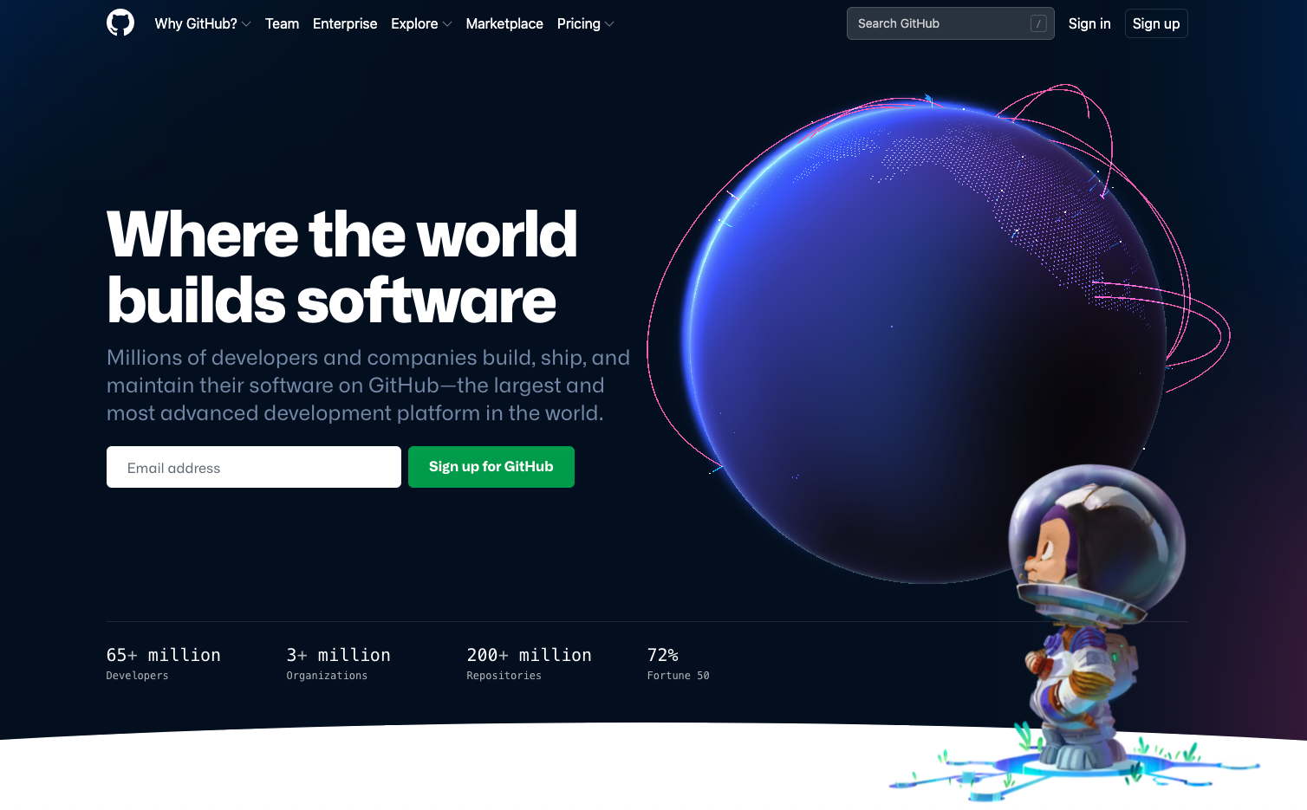
What about version control?
To do version control, we need a host platform, and the one that literally everyone uses is GitHub.
We are going to help you out and give you some goodies as well!
We are going to also give you the GitHub Student Developer Pack!
In order to get it though, we need to get the GitHub account running
To get started, go to https://github.com/
Sign up using your Raleigh Charter Email Address
After you have signed up, search up GitHub Student Developer Pack on Google and then click on the first link and follow the directions.

Slide 7
It might have been a while since you all of coded, so we are going to start from ground 0!
Review of
The Basics

Slide 8
Review of Data
my_list = ['list item', 2, ['hi']]
my_dict = {"name": "Fillip", "tall": True}
my_tuple = ("USERID", "LOCATION")
x = set([1,'guacamole'])
In Python we have a few different types data types
Lists, Dictionaries, Tuples, and Sets
We didn’t really cover Sets last year, but they look like dictionaries, with these differences:
They are unordered
Only unique elements are allowed
Items inside sets cannot be mutable (so no dictionaries or lists)
We also have various types of data in Python
Remember Strings, Floats, Integers, Booleans
Think: Why do we even have different data types in the first place?
my_string = "CompSci"
my_int = 11
my_float = 469.20
my_bool = False
my_what = 3 + 4j #What is this called?
Notes:
More information about Sets: https://realpython.com/python-sets/
Think Answer: BEcause different data types take up different amounts of memory in our computer (i.e. a float is more than an integer). This might not seem important for the small programs we will make, but imagine a program with thousands and thousands of variables, it adds up!

Slide 9
Review of Loops and Conditionals
Fillip = 1.9
if Fillip > 1.82:
print("Fillip is tall")
elif Fillip > 1.65:
print("Fillip is average")
else:
print("Fillip is shorter than Arnav lol")
Remember the almighty if statement in Python!
It’s also important to remember our comparison operators such as the equals (==) and the not equals (!=)
We also have elif and else statements to give our code more flexibility
The two loops in Python are for and while loops
The for loop iterates over a data type a set amount of times, and is useful if we know that amount
The while loop operates as long as a certain condition is met, and is better when we don’t know (or have a variable) amount of times our code wants to run
Please don't run while true if you love your computer (or us)
life = ['school', 'sleeping', 'eating']
while 'school' in life:
homework = True
print("You have homework")
#An example of what NOT to run

Slide 10
Review of Functions
def super_cool_func(name):
new_name = name[1] + name[::-2]
return f"Hello {name}, your new name is {new_name}"
print(super_cool_func("Arnav")) #Hello Arnav, your new name is rvnA
print(super_cool_func("Fillip")) #Hello Fillip, your new name is ipli
Finally, we have the last major topic we covered last year, functions
The layout of a function includes the def keyword, which defines our function, the name of the function, and then any parameters
Remember the return keyword!
Functions usually take in a set of parameters, which we specify when we call the function in terms of arguments
Functions allow us to call the same code over and over again, how many times we want, but modifying the output each time by changing the argument
Functions are great for sectioning off your code into distinct parts, while staying consistent with D.R.Y
Don’t Repeat yourself
Here at CompSci club, we want DRY code
Think: Is Water Wet (Wrong answers only)

Slide 11
Now that you’re brushed up, let’s do some practice about it!
Review
Practice

Slide 12
Problem Set One
Exercise One:
Have the user type in a string and have a loop that reverses the string
Exercise Two:
Create a function that checks whether a password is valid or not: a valid password should include these things:
6 characters long (or more)
At least 1 special character (!@#$%&*)
At least 1 number
Notes:
https://replit.com/join/lzhpwytrya-fillipcutiuba

Slide 13
Problem Set Two
Exercise One:
Make a program where given some dictionaries with the name of the person, their grades for their assignments, labs, and tests (each one being weighed a different amount - 10% assignments, 70% tests, 20% labs)
After the individual average grade is calculated, that grade is going to need to be transferred into a letter grade
After that, a summary needs to be shown for each person and in the end, the average for the whole class needs to be shown
If you have any questions, please ask, this is hard to describe in words.
I will send you the sample dictionaries in an email in a second.

Slide 14
If you have any questions at all, please don’t hesitate to stay back or email one of us!
Thank you!
That is all we have for today!

